Slide 1
Lecture 10 – Unsupervised Representation Learning
Prof. André Gustavo Hochuli
gustavo.hochuli@pucpr.br
aghochuli@ppgia.pucpr.br
Notes:
Prof. André Hochuli

Slide 2
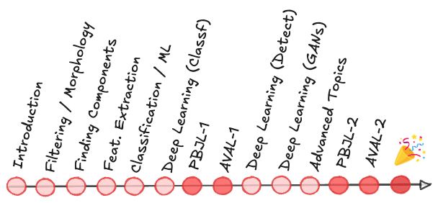
Topics
Review of Lecture 09 – Generative Adversarial Learning
DCGAN
PIX2PIX
Deep Unsupervised Representation Learning
Latent Representations
Auto-Encoders
Representation Learning
Knowlegde Transfer
Practice
Computer Vision - Prof. André Hochuli
Lecture 09
Notes:
Prof. André Hochuli

Slide 3
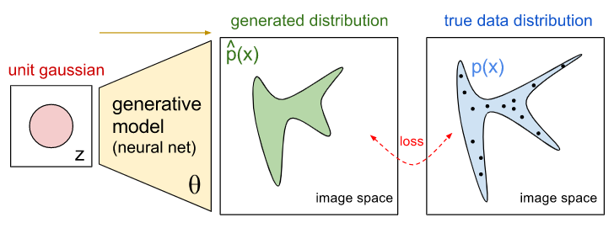
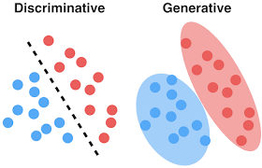
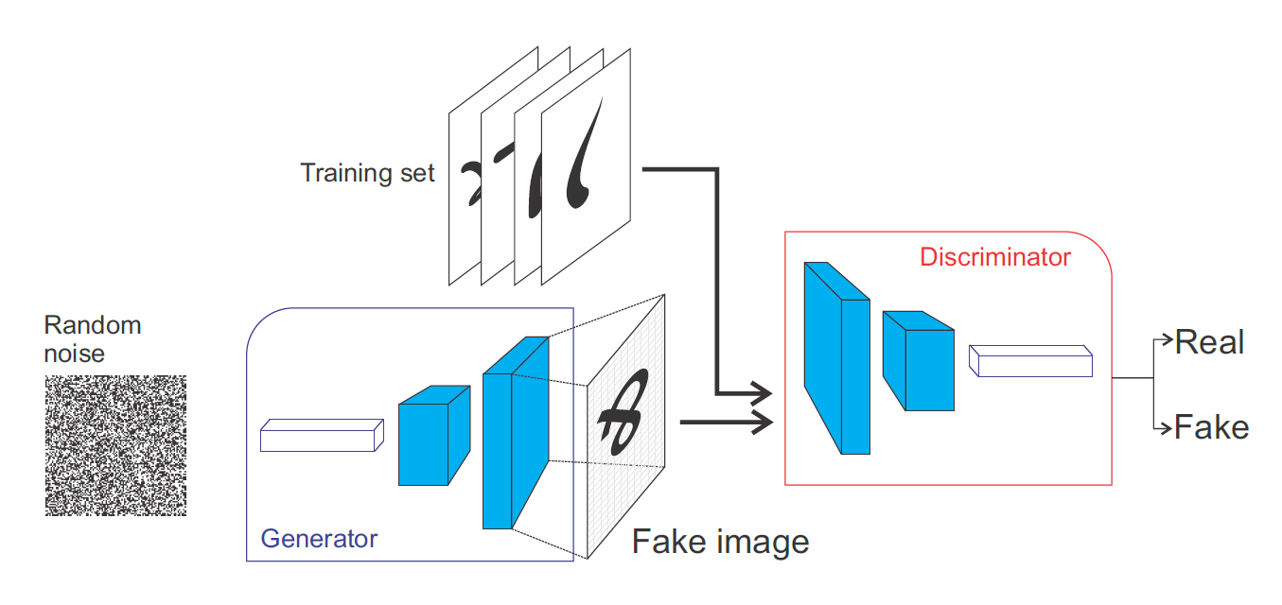
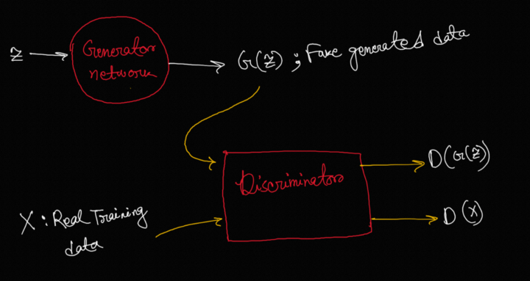
Review Lecture 09 - GANs
Discriminative vs Generative
Deep Generative Networks
Generator – Discriminator Architecture
Generative Loss
Computer Vision - Prof. André Hochuli
Lecture 09
Notes:
Prof. André Hochuli

Slide 4
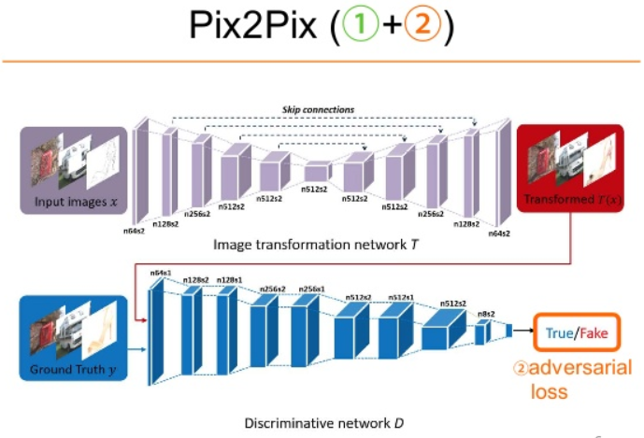
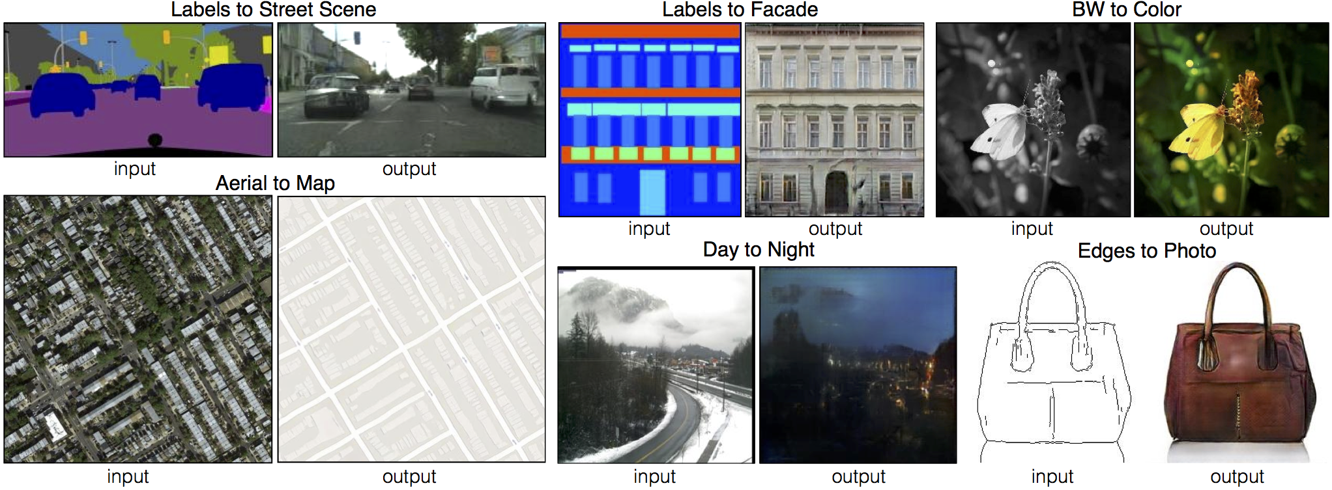
Review Lecture 09 - GANs
Pix2Pix
Encoder-Decoder Architecture
Image Translation Task
Computer Vision - Prof. André Hochuli
Lecture 09
Notes:
Prof. André Hochuli

Slide 5
Unsupervised Representation Learning
Notes:
Prof. André Hochuli

Slide 6
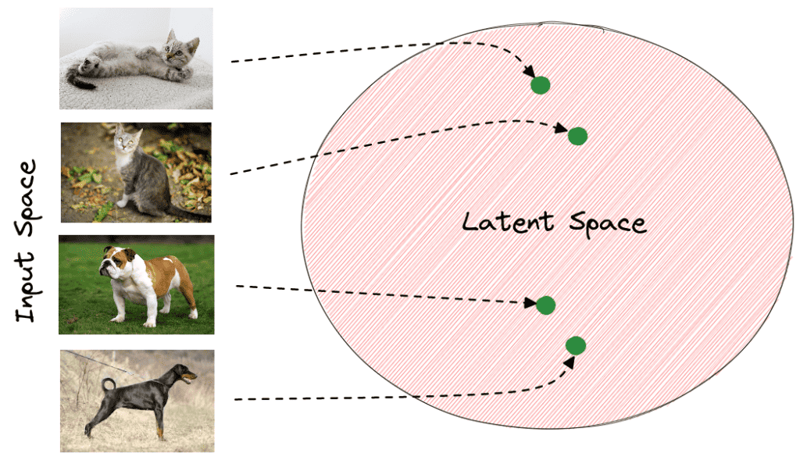
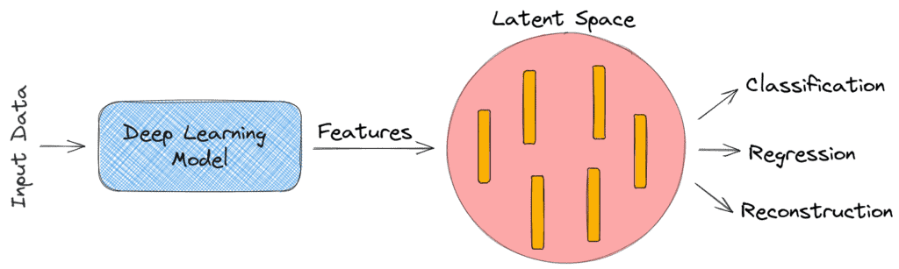
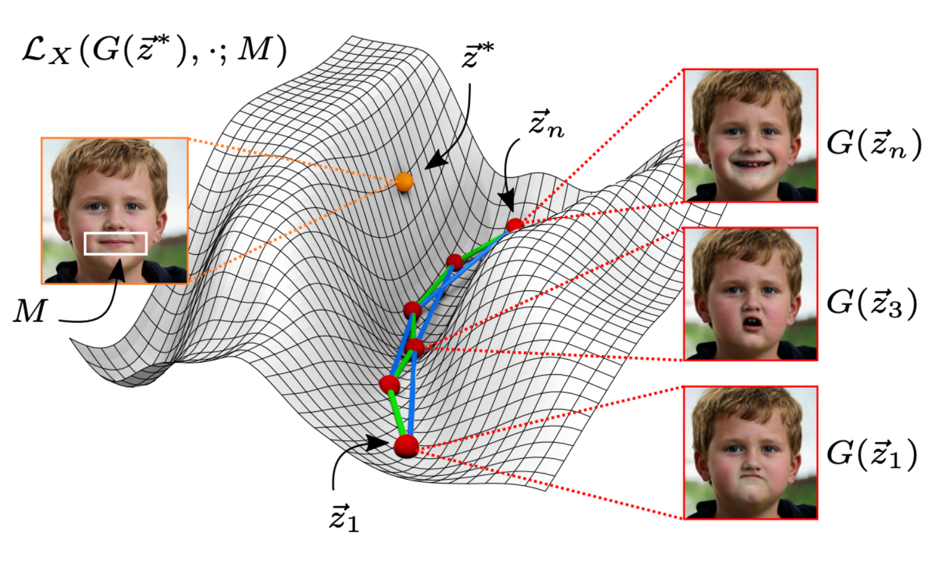
Representation
Representation is a feature of data that can entangle and hide more or less the different explanatory factors or variation behind the data
Image Embeddings, Token Embeddings (NLP)
Latent Space
Bengio, Yoshua, Aaron Courville, and Pascal Vincent. "Representation learning: A review and new perspectives." IEEE transactions on pattern analysis and machine intelligence 35.8 (2013): 1798-1828.)
Computer Vision - Prof. André Hochuli
Lecture 09
Notes:
Prof. André Hochuli

Slide 7


Supervised Learning
Supervised approaches achieve outstanding results in many domains
Dependence on vast annotated datasets
Manual annotation is expensive and time-consuming
Limited scalability to new domains or tasks
Generalization issues across datasets and environments (overfitting)
Need for learning meaningful representations without supervision
Computer Vision - Prof. André Hochuli
Lecture 09
Notes:
Prof. André Hochuli

Slide 8
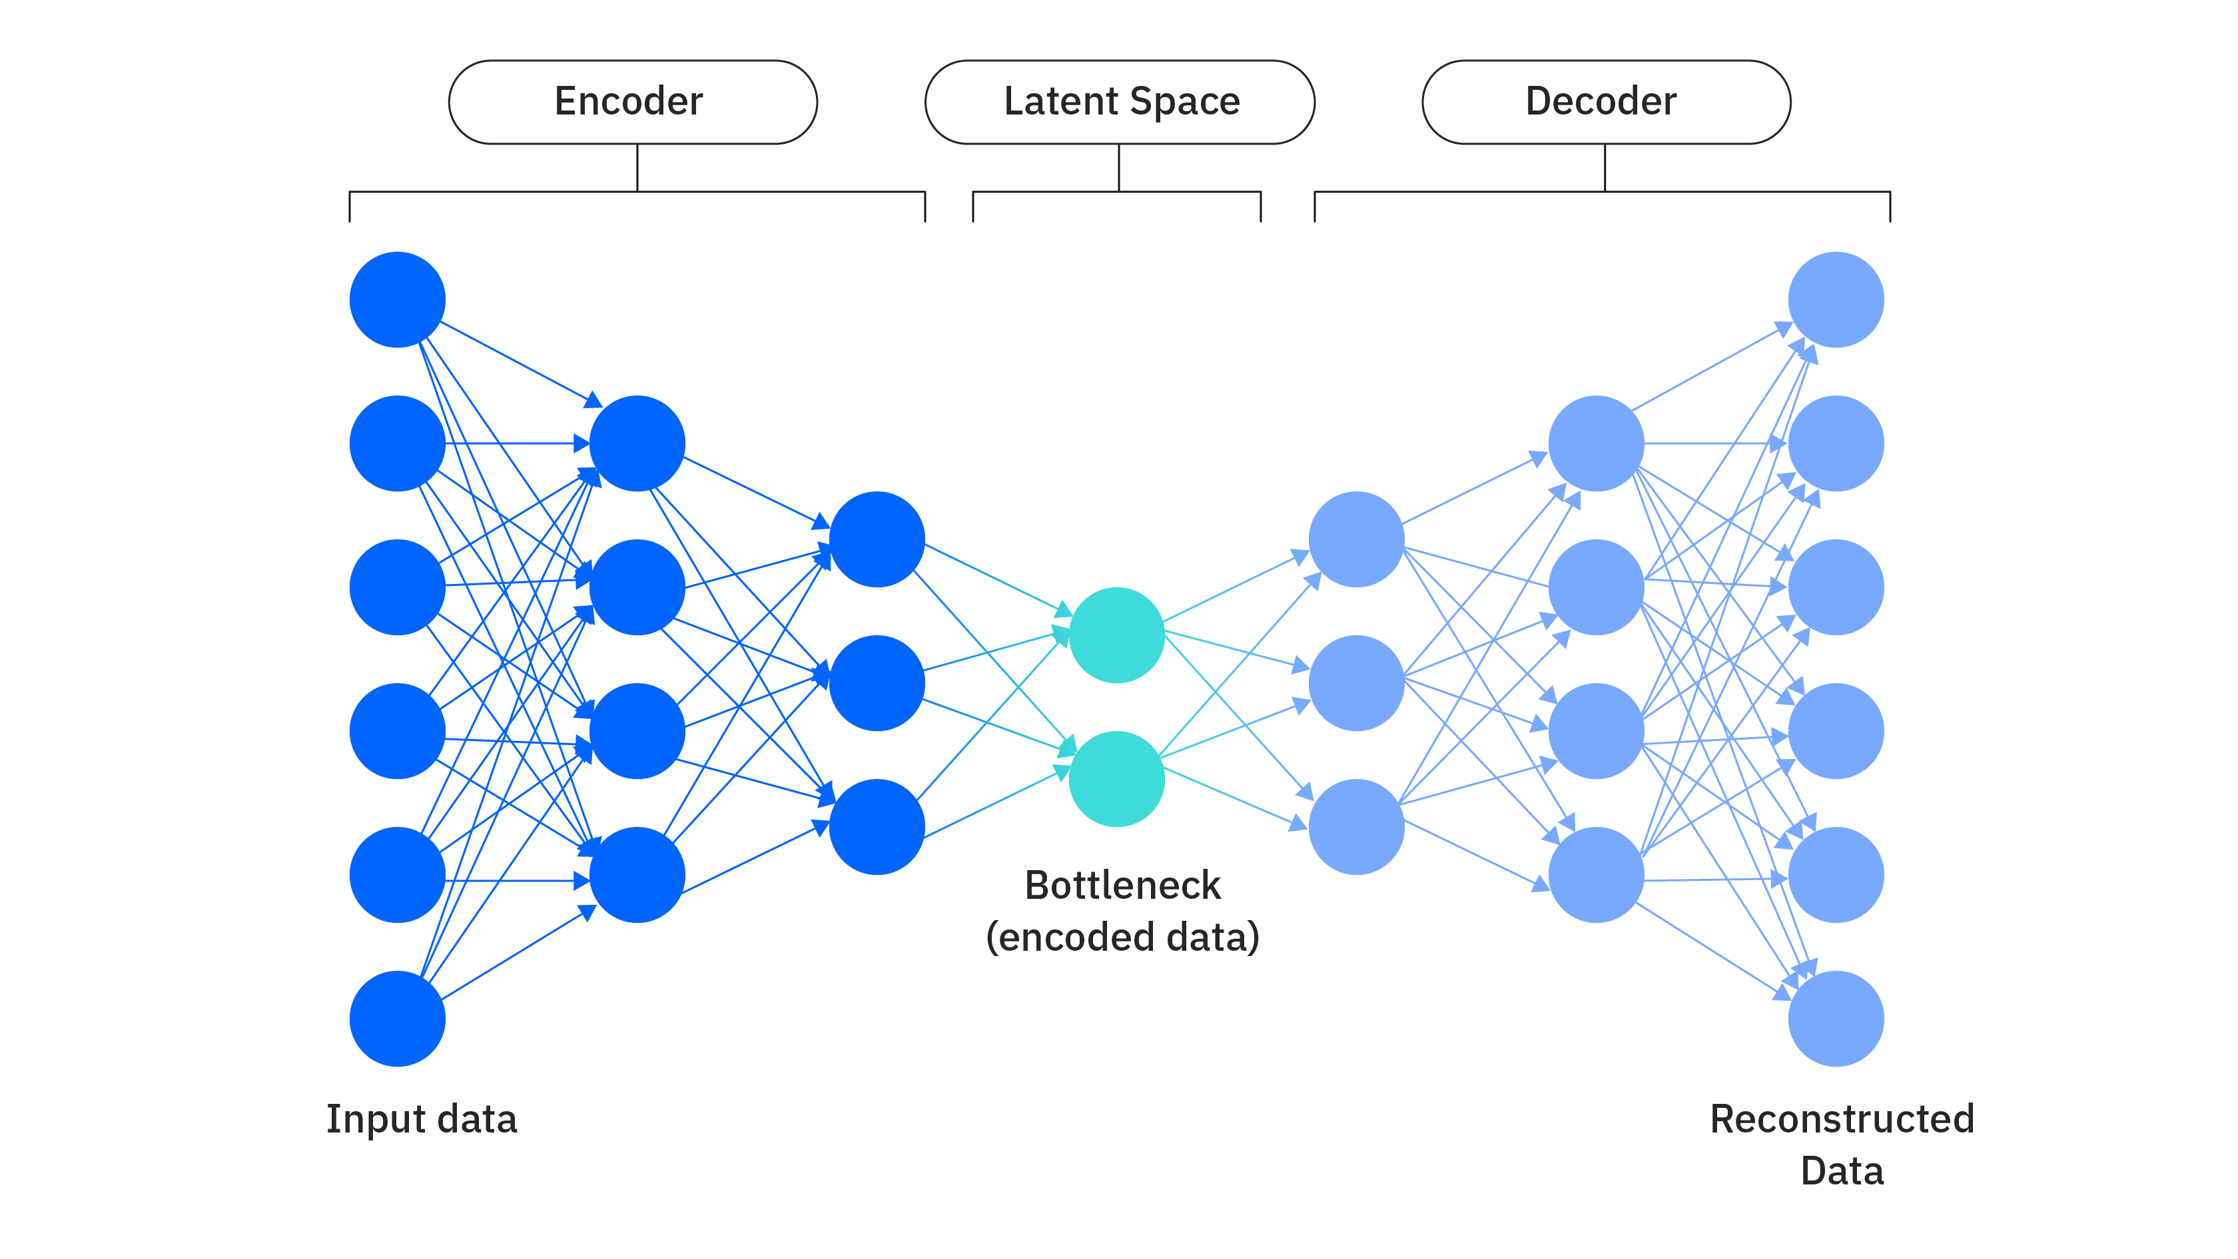
Autoencoders
Unsupervised Learning
Dimensionality Reduction
Clustering
Denoising
Representation Learning
Computer Vision - Prof. André Hochuli
Lecture 09
Notes:
Prof. André Hochuli

Slide 9
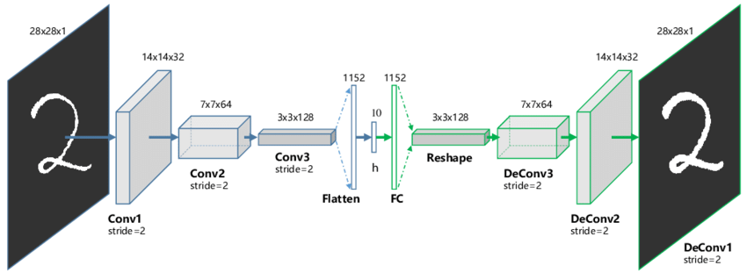
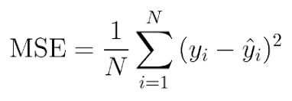
Convolutional Autoencoders
Encoder – Decoder Architecture
Recover the input data
MSE Loss (most common, but others are possible)
Computer Vision - Prof. André Hochuli
Lecture 09
Notes:
Prof. André Hochuli

Slide 10
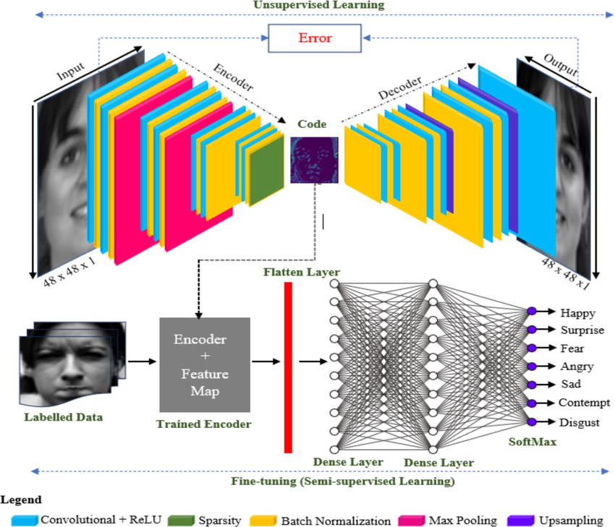
Semi-Supervised Representation Learning
Unsupervised Step
Auto-Encoder Training
Learn Latent Representations
Feature Extraction
Freeze The Encoder
Extract Latent Vectors
Supervised Classifier Training
Input: Latent Vectors (Labeled)
Fully-Connected, SVM, ...
Computer Vision - Prof. André Hochuli
Lecture 09
Notes:
Prof. André Hochuli

